Slide 1
Time Series Analysis

Slide 2
Agenda
Time Series vs Cross Sectional Data
Time Series Modeling Techniques
Stationarity
Time Series Data
ARIMA Model

Slide 3
Time Series vs Cross Sectional Data
Time Series Data | Cross Sectional Data
Data is collected over a period of time, usually equally spaced time intervals | Data come from different individuals or groups at a single point in time
Analysis of time series data is called Forecasting | Analysis of cross sectional data covers supervised and unsupervised learning
Analysis Techniques - ARIMA, Exponential Smoothing, CNN etc. | Analysis Techniques - Linear Regression, Random Forest etc.
Example - Predicting the number of airline passengers based on historical trend | Example - Predicting the salary of employees based their experience and skills

Slide 4
Time Series Modeling Techniques
Auto Regression
Moving Average
ARIMA
SARIMA
ARIMAX
SARIMAX
Exponential Smoothing
Holt Winter’s Exponential Smoothing
Recurrent Neural Networks

Slide 5
Stationarity
Stationary Time Series
Mean is constant over time
Variance is constant over time
Covariance is constant over time
Non-stationary series can be stationarized through Differencing
Dickey Fuller Test is used to test stationarity of series
p<0.05 employs stationarity

Slide 6
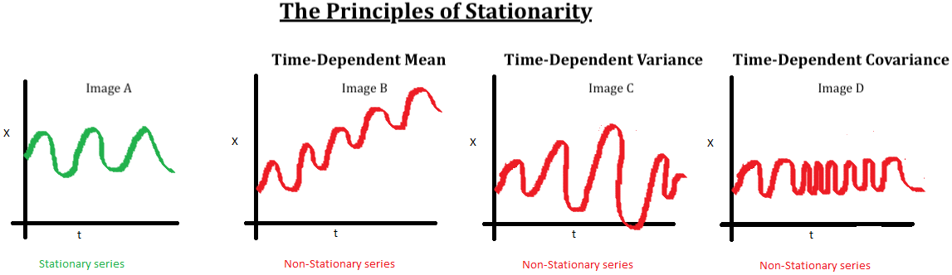
Stationarity
Reference -https://towardsdatascience.com/

Slide 7
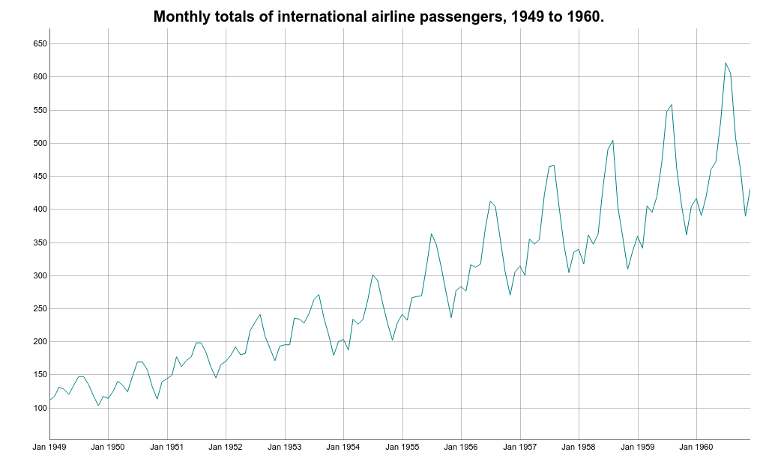
Time Series Data

Slide 8
ARIMA Model
AutoRegression (p)
ŷt = μ + ϕ1 yt-1 + ϕ2 yt-2 + … + ϕp yt-p
Integrator (d)
Differencing of order d is applied to stationarize series
Moving Average (q)
ŷt = θ1et-1 + θ2et-2 + … + θqet-q
ARIMA Model
ŷt = μ + ϕ1 yt-1 + ϕ2 yt-2 + … + ϕp yt-p + θ1et-1 + θ2et-2 + … + θqet-q

